Slide 1
Patient Monitoring System

Slide 2
In Patient Monitoring System electronics Equipments are used to provide continuously check over important characteristics and other parameters of patient.
The main purpose is to check any unbalance in the body which may further cause serious diseases like heart attacks or strokes.

Slide 3
Heart Rate Measurement
Heart rate range 0-250beats per minute.
For adult 72.

Slide 4
Methods to measure heart rate
1 By measuring pulse rate
2 By using a Stethoscope
3 By using ECG Signal
4 By using Cardiotachometer
5 By using Heart Rate Monitor

Slide 5
Pulse Rate Measurement
Pulse Rate – displacement of blood vessels wall which can be felt in some areas of body like wrist . Neck ,temple area behind ear.
Most commonly measured at wrist.

Slide 6
Methods to Pulse Rate Measurement
1 Electrical Impedance Method
2 Strain Gauze Method
3 Photoelectric method
4 Plythsmography

Slide 7
Photoelectric method
Transmittance method

Slide 8
Reflectance method

Slide 9
Plythsmography

Slide 10
Respiration Rate Measurement
Respiration
Oxygen enters and CO2 leaves
Inspiration increase volume of lungs and expiration decrease volumes of lungs.
Inspired air is cooler than expired air.
Range 12 – 18 breaths per minute.

Slide 11
Methods for Respiration Rate Measurement
1 Displacement Method
2 Thermistor Method
3 Impedance Pneumography Method
4. CO2 Method

Slide 12
Impedance Pneumography Method

Slide 13
CO2 Method

Slide 14
Blood Pressure Measurement
Blood pressure is the lateral pressure exerted by blood on vessels wall while flowing through it.
Two Types
1. Systolic Blood Pressure: Pressure exerted on arteries during contraction of heart muscles .
Range 95-140 mm of Hg with 120 mm of Hg being average.
2. Diastolic Blood Pressure: Pressure exerted on veins wall during relaxation of heart muscles.
Range 60-90 mm of Hg with 80 mm of Hg being average.

Slide 15
Methods of Pressure Measurement
1 Direct (Invasive) Method :
In this method a blood vessel must be punctured in order to introduce this sensor.
It causes lot of inconvenience and disturbance to the patient.
This method is used when highest degree of accuracy and continuous monitoring is required.

Slide 16
Direct Method Types:
A Catheterization ( Vessel cut down):
A Catheter is a long tube , inserted in the heart by way of superficial artery or vein.
Further using catheter BP can be measured in two ways.
First way is to introduce saline solution into the catheter so that fluid pressure is transmitted to the sensor outside the body.
Second way is to introduce transducer into the catheter and then pushing it into the required point or the transducer is mounted on the tip of catheter

Slide 17
B Implantation of a Transducer in a vessel or heart:
A transducer is permanently implanted in heart or vessel using major surgery.
Advantages is that the transducer remain fixed at desired position for longer period and gives accurate results.

Slide 18
Indirect (Non – Invasive ) Method:
Indirect methods are used externally with patient.
These produce very little discomfort to the patient.
In these methods external pressure is made equal to the vascular pressure .
Less accurate , thus used for routine monitoring and examinations.

Slide 19
Indirect Methods :
Sphygmomanometer
It is based on the principle that when cuff is inflated above the blood pressures using rubber bulb.
Then it is deflated slowly through needle valve.
When systolic pressure equals cuff pressure then it is observed using stethoscope and sphygmomanometer.
Further cuff is deflated and when diastolic pressure equals cuff pressure then it is observed using stethoscope and sphygmomanometer.

Slide 20
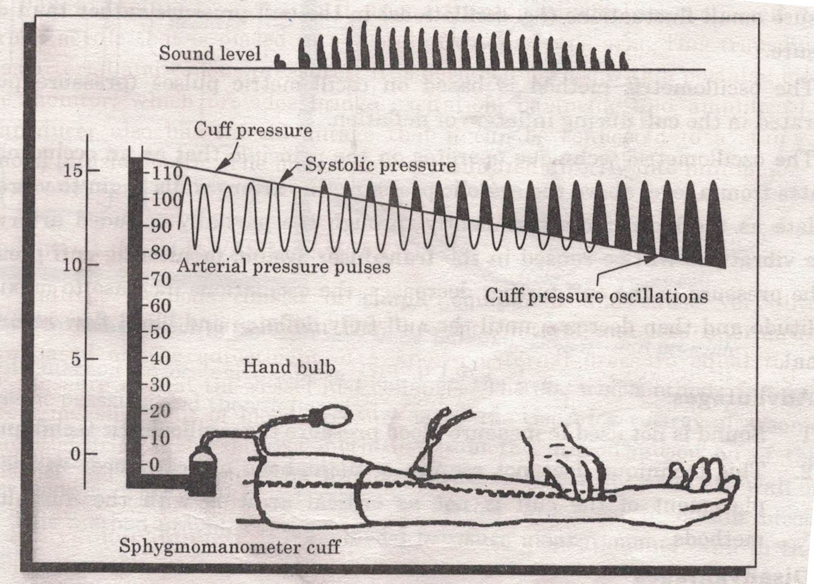
2. Differential Auscultatory Method :
It uses KorotKoff sounds as indirect indicator of blood pressure measurement and it is also called ausculation (use of hearing ) method .
KorotKoff sounds are the
sounds produced by sudden
pulsation of blood through a
partially occluded artery .
A special cuff mounted sensor is used consisting of pressure sensing elements.

Slide 21
3. Ultrasonic Doppler shift Method :

Slide 22
3. Ultrasonic Doppler shift Method :
In This method pressure is measured based on ultrasonic detection of arterial wall motion.
Wall motion signals are detected during systole and diastole.
Wall motion signal are detected based on ultrasonic Doppler shift principle- in which frequency of transmitted signal is shifted due to back scatter from moving blood particles.

Slide 23
PACEMAKER:
The normal beating of the heart is due to triggering pulses that originates in the sinoartrial (SA) node which is also called Natural Pacemaker.
Some times natural pacemaker does not function properly ---- so we need an artificial pacemaker.
Artificial pacemaker is used to stimulate a rhythmic heart beat by using electrical pulses .

Slide 24
NEED of Artificial Pacemaker:
By giving external stimulation impulses it is possible to regulate the heart rate.
In some cases heart beat may b slow as compare to normal heartbeat or may be fast. So it regulate or control the heart beat and make it normal.

Slide 25
Pacemaker System
A Pacemaker unit consist of two parts-
(i) An Electronic Unit- which generates stimulating impulses of controlled rate and amplitude (pulse Generator)
(ii) The Leads : Which carries pulses from the pulse generator to heart.
These perform two main functions
Sensing- A pacemaker sense the rate of heart beat.
Pacing – If heart beat sensed is slow then pacemaker accelerate the heartbeat and make it normal and vice versa.

Slide 26
Types of Artificial Pacemaker
1. Internal Pacemaker
2. External Pacemaker

Slide 27
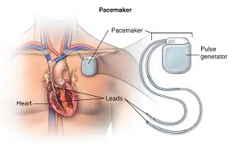
Internal Pacemaker
It is permanently implanted in patients whose SA nod has failed to function properly.
In this entire system is inside the body i.e. electrodes , electronic circuitry , and power supply.

Slide 28
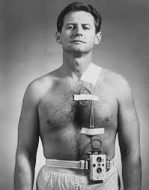
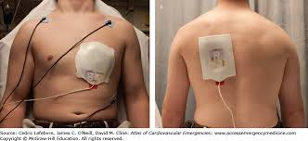
External Pacemaker
It consist of an externally worn pulse generator connected to electrodes located on myocardium.
These are used on patients with temporary heart irregularity like arrhythmias.

Slide 29
Difference between external Pacemaker and internal Pacemaker

Slide 30
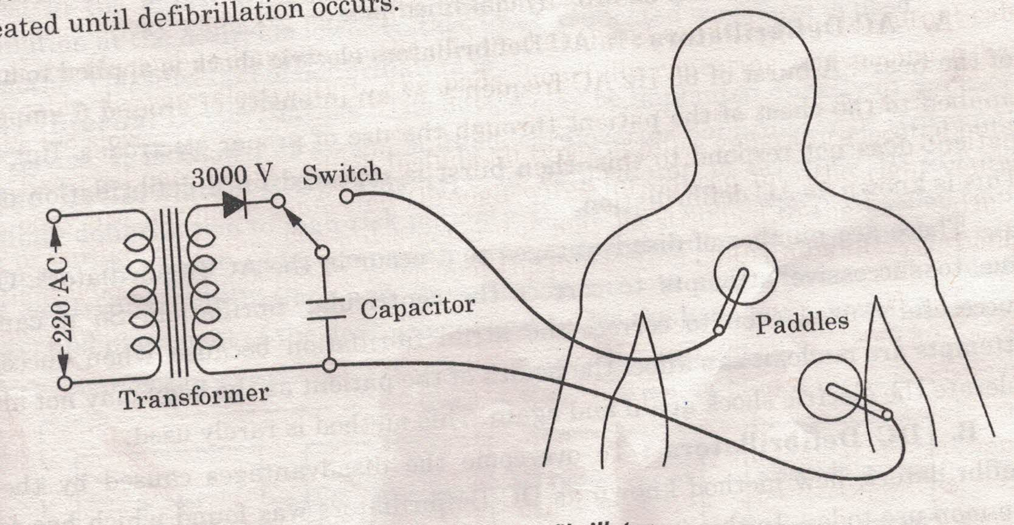
Defibrillator

Slide 31
Types of Defibrillator
AC
DC
ICD
AED

Slide 32
AC Defibrillator:

Slide 33
AC Defibrillator
Fibrillation-The synchronization between artria and ventricles of heart by which it can perform the function of pumping blood to each part of body .
If the synchronization between artria and ventricles is lost then this condition is called Fibrillation.
During fibrillation heart will not work properly and may lead to disastrous results even to death of patient.
Defibrillation- The process by which a high voltage signal of around 6A current is applied to patient for around 0.25 sec to 1 sec to establish synchronization.

Slide 34
DC Defibrillator

Slide 35
ICD –Internal Cardiac Defibrillator

Slide 36
Use of Microprocessor in Patient Monitoring System
Do Your self.

